Slide 2
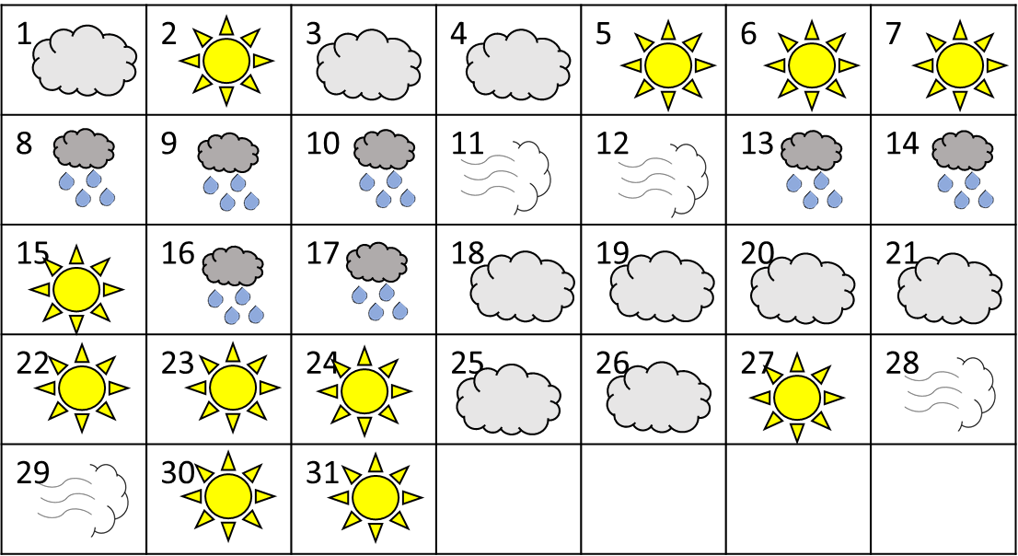
Jack has recorded the weather each day during March.
What do you notice?
Use the information to create a tally chart.
Have a think

Slide 3
Weather | Tally | Total
 |  | 11
 |  | 9
 |  | 7
 |  | 4

Slide 4
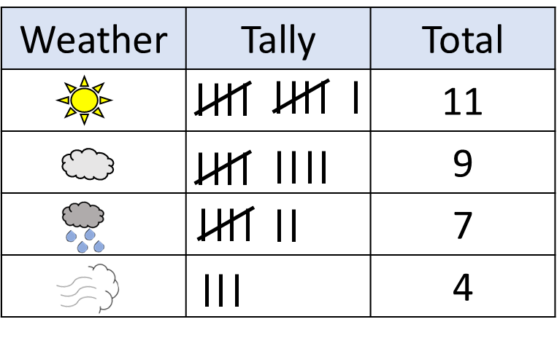
Jack is using his tally chart to create a pictogram.
Can you complete the pictogram?
Key $=$ 2 days
Weather
Have a think

Slide 5
Jack uses his tally chart to create a bar chart.
March Weather
12
10
8
6
4
2
Have a think
0
Can you complete the bar chart?

Slide 6
The children have been counting the daffodils.
There are fewer than 40 daffodils
The total is a multiple of 3
There are an even number of daffodils.
The total is 2 less than a multiple of 8
How many daffodils could there be?
Have a think

Slide 7
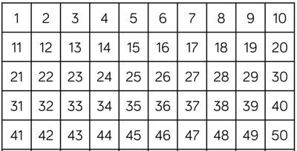
There are fewer than 40 daffodils
The total is a multiple of 3
There are an even number of daffodils.
8 $−$ 2 $=$ 6
16 $−$ 2 $=$ 14
The total is 2 less than a multiple of 8
24 $−$ 2 $=$ 22
32 $−$ 2 $=$ 30

Slide 8
Whitney has fewer than 20 lettuce seeds.
If she plants them in rows of 4, she has 3 left over.
If she plants them in rows of 5, she has 4 left over.
How many seeds does Whitney have?
Have a think

Slide 9
Whitney has fewer than 20 lettuce seeds.
If she plants them in rows of 4, she has 3 left over
If she plants them in rows of 5, she has 4 left over.
1 row of 4 $+$ 3 $=$ 7
1 row of 5 $+$ 4 $=$ 9
2 rows of 4 $+$ 3 $=$ 11
2 rows of 5 $+$ 4 $=$ 14
3 rows of 4 $+$ 3 $=$ 15
3 rows of 5 $+$ 4 $=$ 19
4 rows of 4 $+$ 3 $=$ 19
4 rows of 5 $+$ 4 $=$ 24
5 rows of 4 $+$ 3 $=$ 23
Whitney has 19 seeds.

